Slide 1
C Program: Rapid Calculation of Molecular Orbitals
Heng Xu

Slide 2
Why do we need a C program?
1+1=?
17688+1233×37=?
#include<stdio.h>
int main()
{
int a;
a=1+1;
printf(“%d”,a);
return 0;
}
#include<stdio.h>
int main()
{
int a;
a=1+1;
printf(“%d”,a);
return 0;
}

Slide 3
C programs: to get rid of annoying tasks
To calculate the molecular orbital of
Hψ=Eψ ψ=c₁φ₁+ c₂φ₂+ c₃φ₃+ c₄φ₄
H₁₁-ES₁₁
H₁₂-ES₁₂
H₁₃-ES₁₃
H₁₄-ES₁₄
C₁
H₂₁-ES₂₁
H₂₂-ES₂₂
H₂₃-ES₂₃
H₂₄-ES₂₄
C₂
=0
H₃₁-ES₃₁
H₃₂-ES₃₂
H₃₃-ES₃₃
H₃₄-ES₃₄
C₃
H₄₁-ES₄₁
H₄₂-ES₄₂
H₄₃-ES₄₃
H₄₄-ES₄₄
C₄

Slide 4
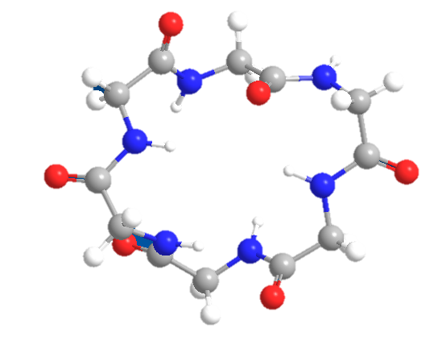
Basic logic
Information that your computer can understand
Your computer do the calculation
transform
Chemical structure

Slide 5
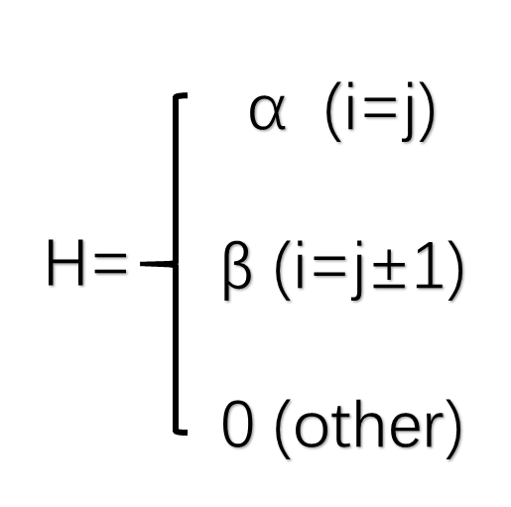
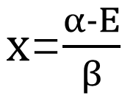
1. Transformation of Chemical Structures
To calculate the molecular orbital of
H₁₁-ES₁₁
H₁₂-ES₁₂
H₁₃-ES₁₃
H₁₄-ES₁₄
x
-1
0
0
H₂₁-ES₂₁
H₂₂-ES₂₂
H₂₃-ES₂₃
H₂₄-ES₂₄
-1
x
-1
0
H₃₁-ES₃₁
H₃₂-ES₃₂
H₃₃-ES₃₃
H₃₄-ES₃₄
0
-1
x
-1
H₄₁-ES₄₁
H₄₂-ES₄₂
H₄₃-ES₄₃
H₄₄-ES₄₄
$x$=$\frac{α-E}{β}$
0
0
-1
x
|D_{n}|
Linkage between Carbon atoms
Carbon atoms in the chain

Slide 6
Equation that computers use
x
-1
0
0
|D_{n}|
=
-1
x
-1
0
=
0
0
-1
x
-1
0
0
-1
x
x
-1
0
=
x
-1
|D_{n-1}|
|D_{n-2}|
x
=
-1
x
-1
+
x
+
-1
x
0
-1
x
Two things to figure out: (1) n and (2) x.

Slide 7
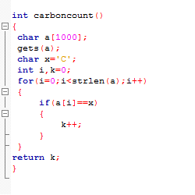
Coding A: Counting the number of carbon
Draw the chemical structure below:
CH₂=CH-CH=CH-CH=CH₂
n=carboncount();

Slide 8
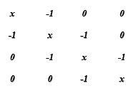

Coding B: Calculation
=
0
D₄
Molecules with 4 carbons
4 Solutions of x
4 groups of Solutions of C₁-C₄

Slide 9
Coding B: Calculation of x and c
x
-1
0
…
0
0
-1
x
-1
…
0
0
…
…
…
…
…
…
=
0
…
…
…
…
x
…
-1
0
0
…
0
-1
x
C_{n}
Molecules with n carbons
(Nobel prize in chemistry)
D_{n}
n Solutions of x
n groups of Solutions of C₁-C_{n}

Slide 10
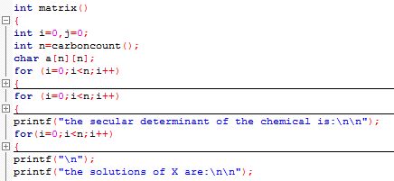
Coding B1: Calculation of x
|D_{n}|
=
|D_{n-1}|
|D_{n-2}|
x
+

Slide 11
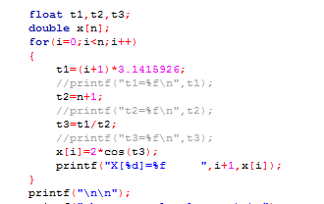
Coding B1: Calculation of x
|D_{n}|
=
|D_{n-1}|
|D_{n-2}|
x
+
n solutions of x

Slide 12
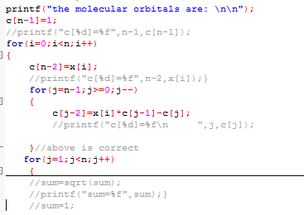

Coding B2: Calculation of c
n groups of Solutions of C₁-C_{n}

Slide 13
Constants we have got
(1) n → the number of carbon atoms
(2) x → the position of carbon atoms
(3) c → electron distribution
Further calculation:
Energy level, charge density and bond strength

Slide 14
Summary
1. C program for Molecular Orbital calculation.
Almost all the molecular information.
2. Interdisciplinary use of knowledge.
C program & Chemistry → easy way to solve difficult problems.
3. Logic is much more important than programing itself.

